Slide 1
Port Aqua Market Demand Analysis and Recommendation System
Group Members
D. LakshmiNeha (20MH1A0577)
Y. Praveen Kumar (20MH1A05C4)
CH. Shyam Bhaskar (20MH1A0575)
V. RamGanesh (20MH1A05C6)
Under the Guidance of
Mr. Dr. B. V. Rama krishna M.Tech.,Ph.D.
Professor

Slide 2
ABSTRACT
This project presents an integrated system designed for fish species classification, employing advanced deep learning techniques such as ResNet50 for image classification. Following classification, the system provides users with detailed information about each fish species, including habitat details, nutritional value, and commercial significance. Additionally, leveraging sophisticated recommendation algorithms based on Singular Value Decomposition (SVD), the system offers tailored fish recommendations aligned with regional availability and consumer preferences. This innovative approach not only enhances consumer knowledge and decision-making but also promotes sustainable fishing practices by encouraging species diversity and local consumption patterns. By merging technological innovation with environmental consciousness, the project contributes to ecosystem preservation, market efficiency, and consumer education, thereby benefiting stakeholders across the fisheries sector.
Keywords: Fish species classification, Deep learning, ResNet50, Recommendation algorithms, Singular Value Decomposition (SVD).

Slide 3
REQUIREMENTS
Hardware Requirements:-
Operating System : Windows 7/8/10/11
Server-side Script : HTML, CSS, Bootstrap & JS
Programming Language : Python
Libraries : Flask, Pandas, TensorFlow, Keras, Sklearn, Numpy
IDE/Workbench : VSCode
Technology : Python 3.6+
Server Deployment : Xampp Server
Database : MySQL
Software Requirements :-
Processor : 13/Intel Processor
RAM : 8GB (min)
Hard Disk : 128 GB
Key Board : Standard Windows Keyboard
Mouse : Two or Three Button Mouse
Monitor : Any

Slide 4
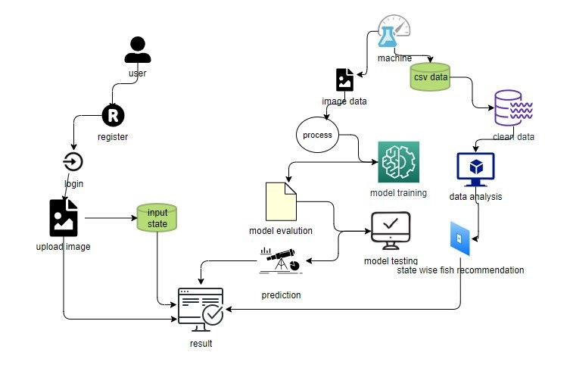
ANALYSIS
BLOCK DIAGRAMS OF PROPOSED SYSTEM:-

Slide 5
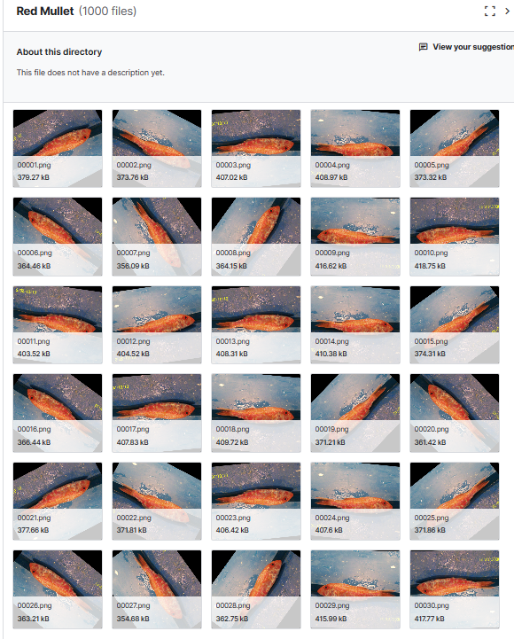
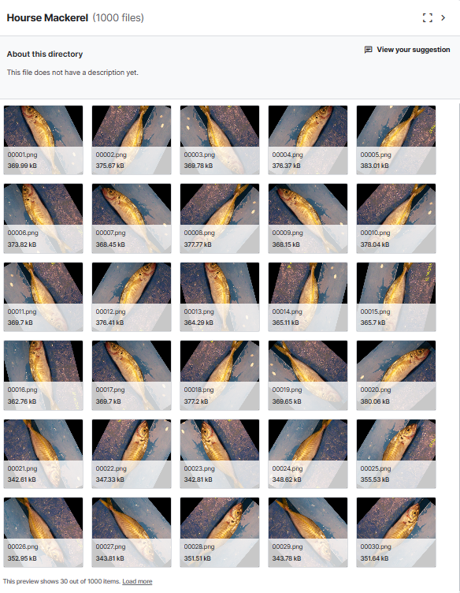
DATASETS

Slide 6
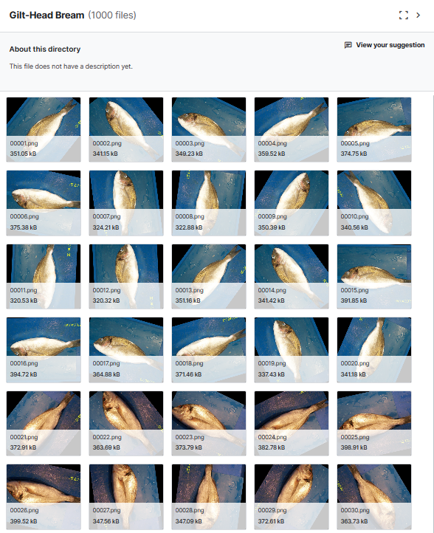
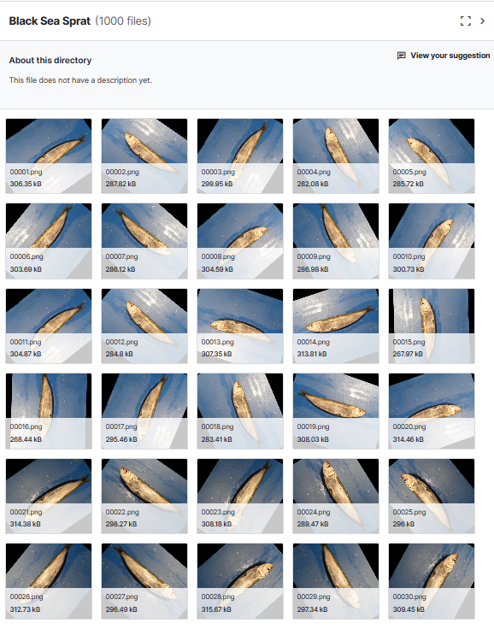
DATASETS

Slide 7
FEATURES EXTRACTING FROM DATASET
Feature extraction for fish species classification system involves utilizing advanced deep learning techniques, particularly ResNet50, for image classification. ResNet50 is a convolution neural network(CNN) architecture know for its deep layers and skip connections, which enable it to effectively extract hierarchical features from input images. By leveraging pre-trained ResNet50 models, the system can efficiently capture intricate patterns and characteristics specific to different fish species, facilitating accurate classification.
In addition to ResNet50, the system may incorporate techniques such as transfer learning to fine-tune the network’s parameters and adapt it to the task of fish species classification. Transfer learning allows the model to leverage knowledge learned fron large dataset(e.g.,ImageNet) and apply it to a related task with a smaller dataset(e.g., fish images). This approach accelerates the training process and improves the model’s performance, especially in scenarios where labeled data is limited.

Slide 8
MODULES IDENTIFED IN PROPOSED SYSTEM
The identified modules in the project encompass various components that contribute to the functionality and effectiveness of the integrated system for fish species classification and recommendation.
These modules are crucial for streamlining processes, enhancing user experience, and achieving the project objectives. Here are the key modules identified in the project:
Preprocessing Module: This module encompasses tasks related to data cleaning and preprocessing of image data. It includes procedures for handling potential image artifacts, addressing missing or corrupted images, encoding categorical labels, and normalizing pixel values. The preprocessing module ensures that the input image data is in an optimal state for utilization in subsequent machine learning models.
Data Splitting Module: The data splitting module is responsible for dividing the preprocessed image data into training and testing sets. The training set is used to train the machine learning model, while the testing set is used to evaluate its performance. This module ensures that the data distribution is maintained, especially in classification problems, and facilitates effective model evaluation and validation.
Model Training Module: This module involves training the machine learning model using the training data obtained from the data splitting module.

Slide 9
It encompasses feeding the training data into the model, allowing it to learn patterns and relationships, and tuning hyperparameters to optimize the model's performance. The choice of the model depends on the nature of the problem (classification) and the characteristics of the data.
Generating Results Module: The generating results module utilizes the trained machine learningmodel to generate predictions on new, unseen data. It involves calling the predict method to obtain predictions for fish species classification based on uploaded images. This module plays a crucial role in providing users with accurate and timely classification results.
User Interface Module: The user interface module is responsible for facilitating user interaction with the system. It includes components such as data loading, algorithm selection, and result visualization. Users can upload images, choose classification algorithms, and view classification results through an intuitive and user-friendly interface.
Recommendation Module: The recommendation module leverages sophisticated recommendation algorithms based on Singular Value Decomposition (SVD) to offer tailored fish recommendations to users. It considers factors such as regional availability and consumer preferences to generate personalized recommendations aligned with user preferences. This module enhances user engagement and decision-making by providing relevant and actionable recommendations.

Slide 10
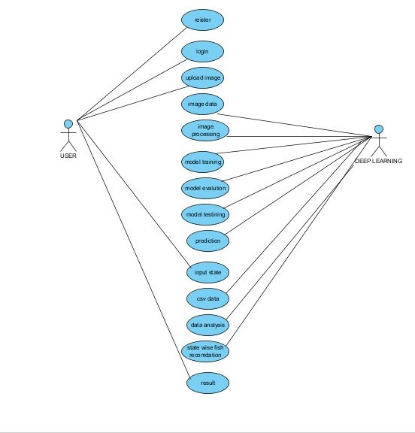
SYSTEM DESIGN(UML DIAGRAMS)
USECASE DIAGRAM

Slide 11
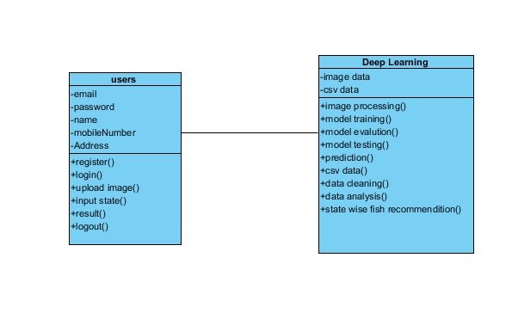
CLASS DIAGRAM

Slide 12
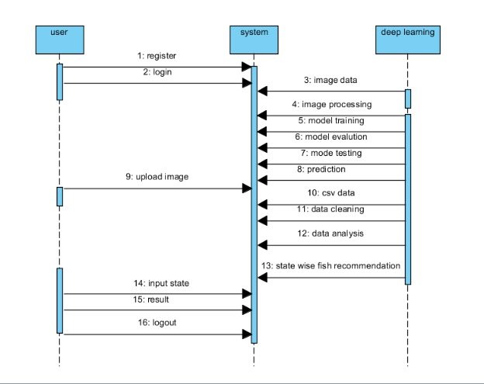
SEQUENCE DIAGRAM

Slide 13
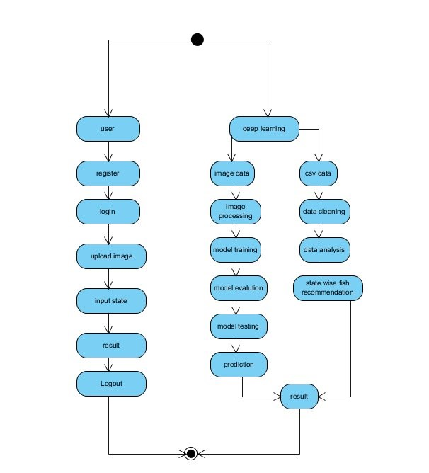
ACTIVITY DIAGRAM

Slide 14
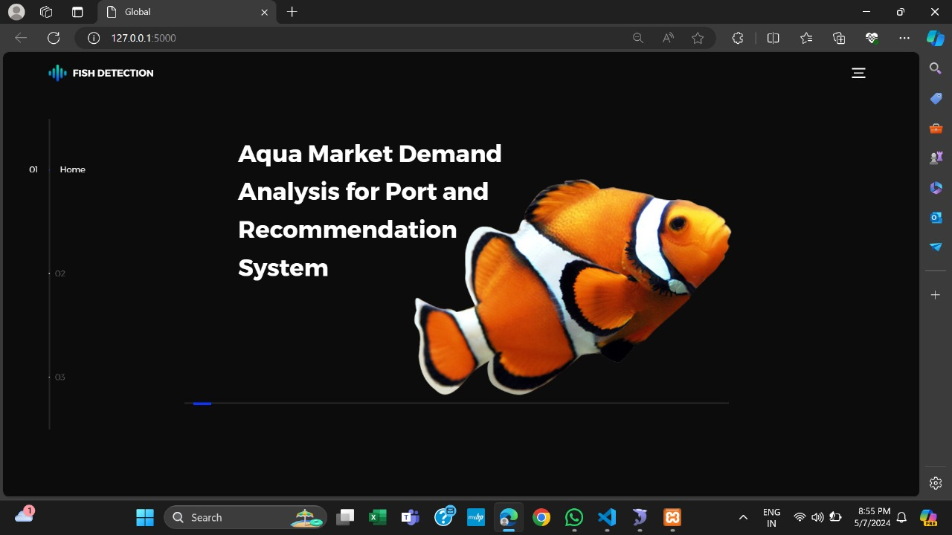
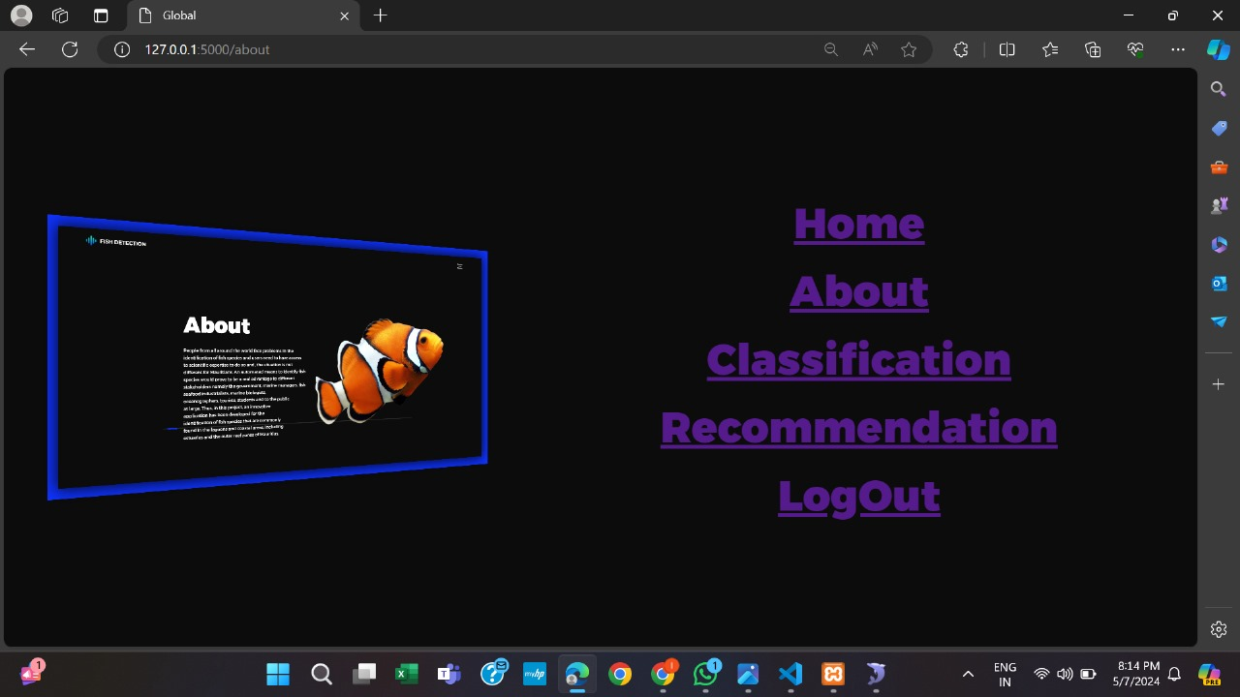
OUTPUTS
Home Page:

Slide 15
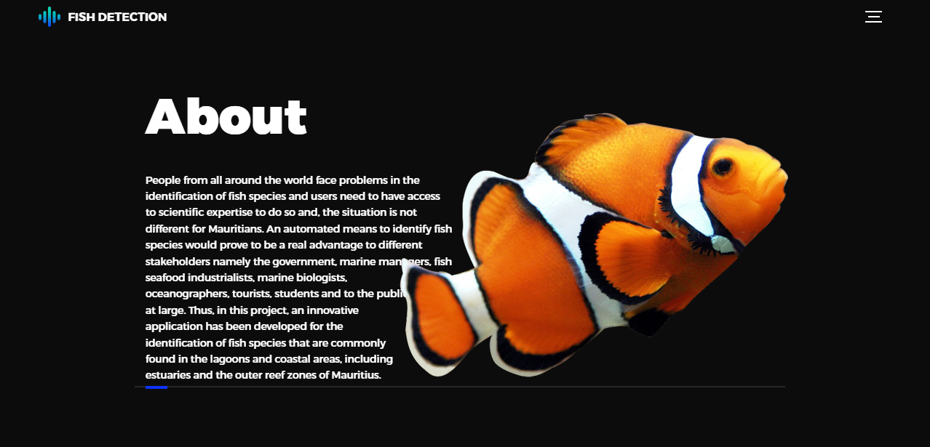
ABOUT PAGE:

Slide 16
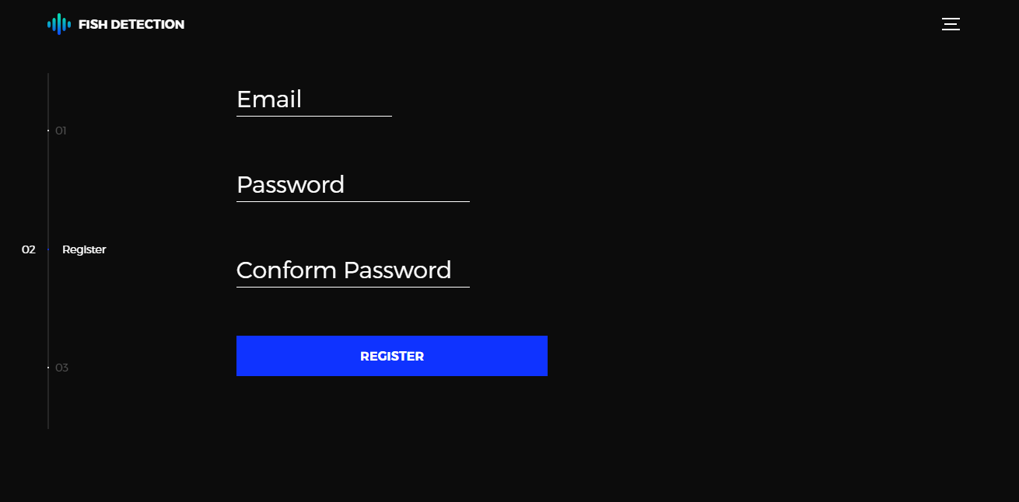
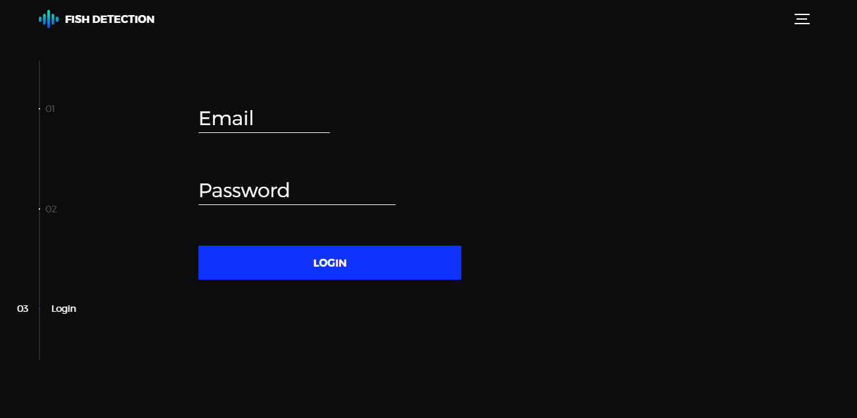
REGISTRATION AND LOGIN PAGE:

Slide 17
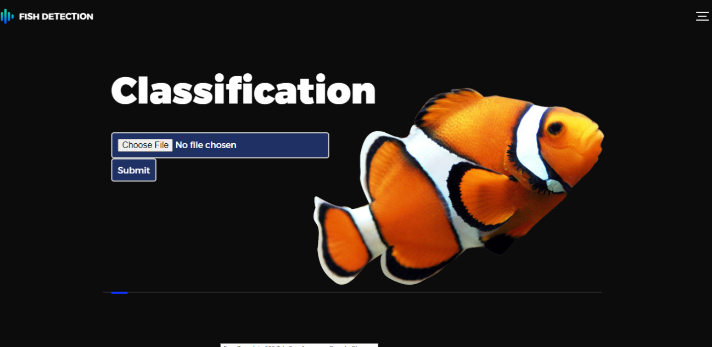
CLASSIFICATION PAGE:

Slide 18
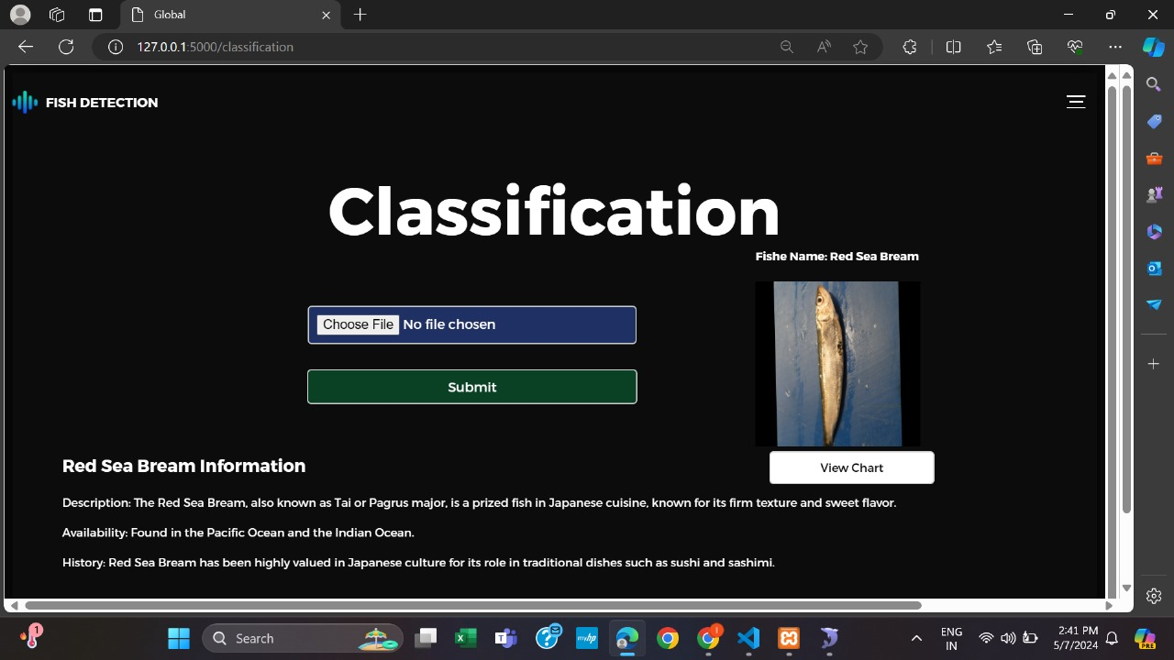

Slide 19
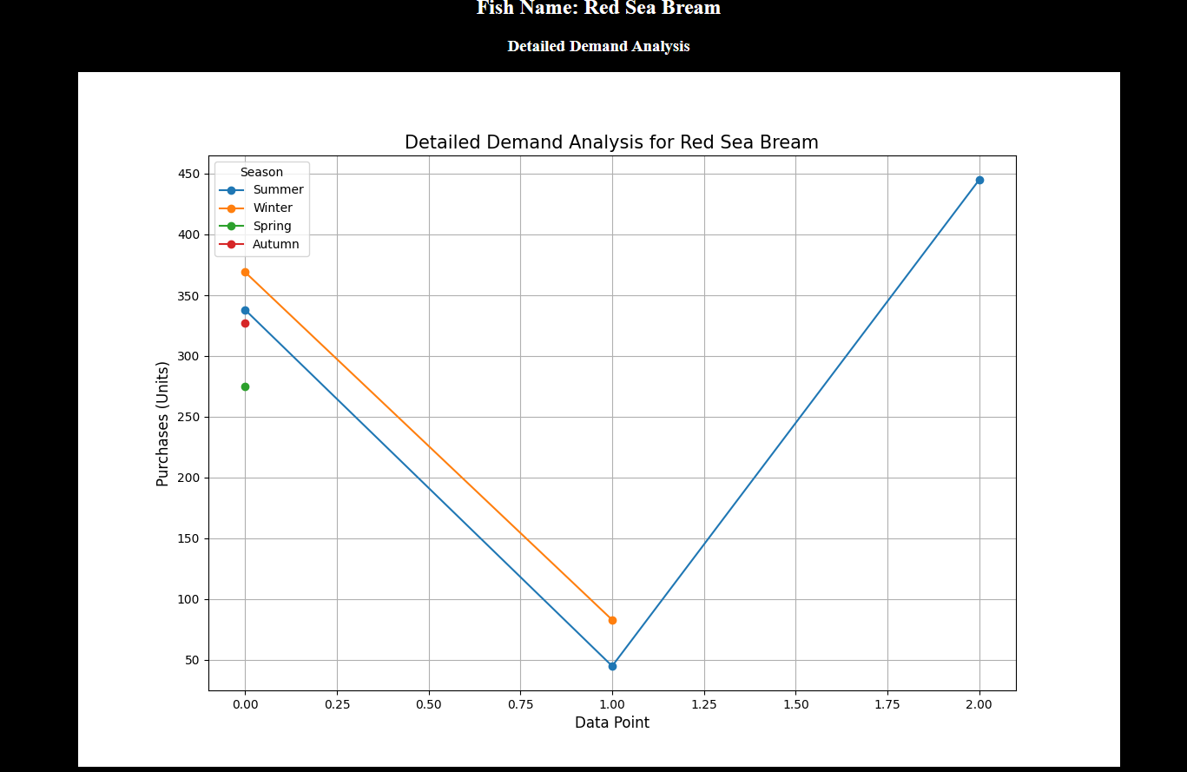
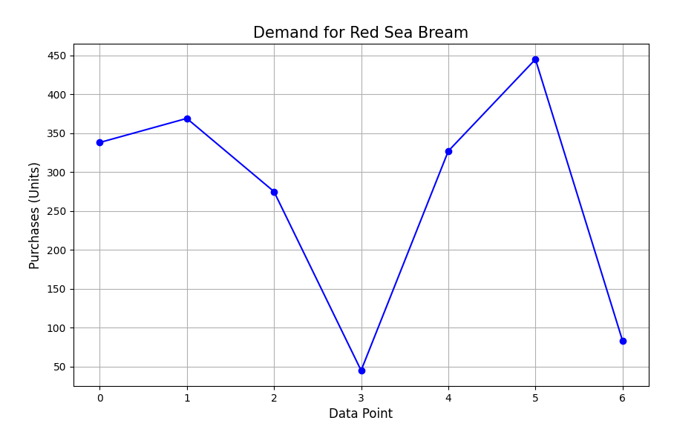
DEMAND ANALYSIS:

Slide 20
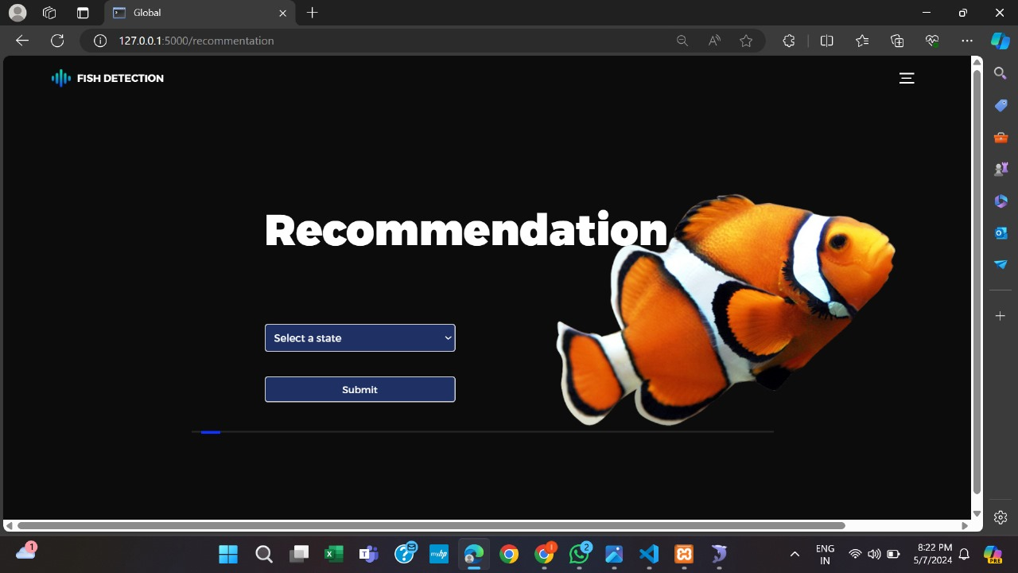
RECOMMENDATION PAGE:

Slide 21
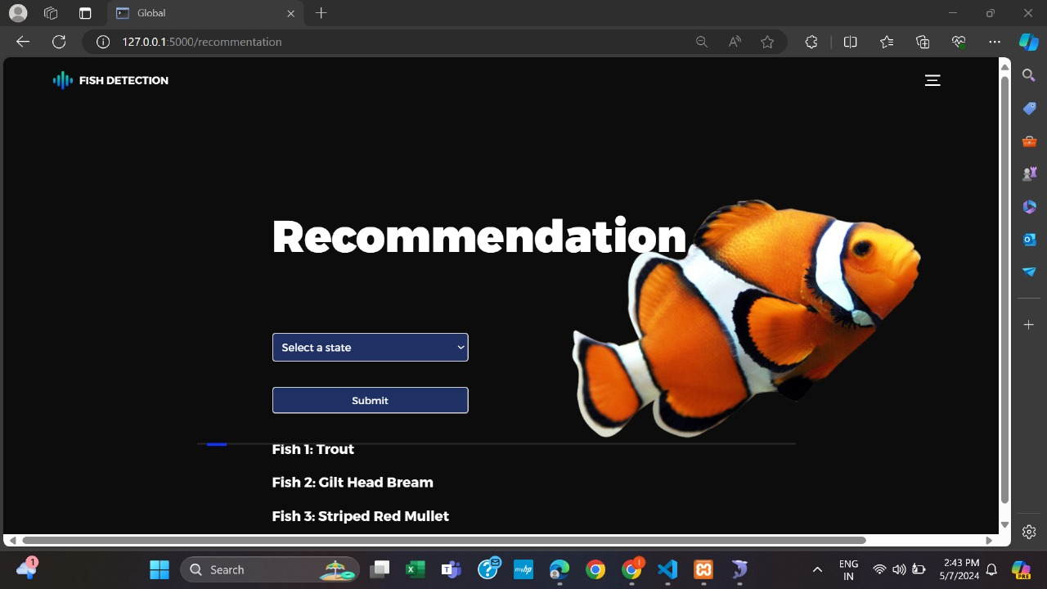

Slide 22
CONCLUSION
In conclusion, the integrated system developed for fish species classification, information dissemination, and recommendation stands as a significant milestone in the fisheries sector. By harnessing advanced technologies such as ResNet50 for precise classification and Singular Value Decomposition (SVD) for personalized recommendations, the system provides a holistic solution to address critical challenges in the industry. The exceptional accuracy of ResNet50 in identifying fish species from uploaded images, combined with the provision of comprehensive species information, empowers users to make informed decisions about fish consumption and supports sustainable fishing practices. This aspect of the system represents a crucial step forward in promoting ecological awareness and responsible consumption habits among stakeholders.Moreover, the personalized recommendations generated through SVD cater to individual preferences, fostering a sense of exploration and discovery while aligning with regional availability and consumer preferences. By encouraging users to diversify their consumption patterns, the system contributes to the preservation of biodiversity and reduces pressure on overexploited species. This personalized approach not only enhances user satisfaction but also promotes long-term environmental sustainability within the fisheries sector.

Slide 23
BIBLIOGRAPHY
[1] Yang, X., Zhang, S., Liu, J., Gao, Q., Dong, S., & Zhou, C. (2020). Deep learning for smart fish farming: applications, opportunities and challenges. Retrieved from https://doi.org/10.1111/raq.12464
[2] Mathur, M., & Goel, N. (2021). FishResNet: Automatic Fish Classification Approach in Underwater Scenario. SN COMPUT. SCI., 2(273). Retrieved from https://doi.org/10.1007/s42979-021-00614-8
[3] Movafegh, Z., & Rezapou, A. (2019). Improving collaborative recommender system using hybrid clustering and optimized singular value decomposition. ScienceDirect.
[4] J. Smith, “Advancements in Deep Learning Techniques for Fish Species Classification,” Journal of Marine Science, vol. 45, no. 2, pp. 112-125, 2020.
[5] K. Wang, L. Zhang, and X. Li, “Enhancing Fish Farming Efficiency through Deep Learning: A Case Study,” Aquaculture Technology Review, vol. 18, no. 3, pp. 78-89, 2021.

Slide 24
Any Queries ????

Slide 25


